Slide 1
Disaster Prediction from the Analysis of Twitter Tweets
Submitted by:
Abhishek Sharma (as222467)
Anirudh Muralidharan (am223859)
Austin Taack (act2667)
Aupal Mondal (am87383)
Saptarshi Mondal (sm72999)
Soorya Sriram (s9623)
Data Science Laboratory Project
EE 460J
PRESENTER OR SPEAKER NAME
Position/Role, The University of Texas at Austin

Slide 2
Introduction
Natural disaster events get a lot of traction especially on social media where everybody is sharing this message to everybody else.
This in turn causes a spread of misinformation and promotes hysteria and panic which is unwanted. To combat this problem, the team has decided to develop a model which can decide whether a particular message about a natural disaster is true or not.
The team believes that real disaster events often include certain information which is not available when it is a false alarm.
The team has decided to train a model to recognize which messages are true and which messages are false.
The team then scrapes through a social media app, in this case twitter, and runs the resultant dataset of tweets with our model to predict which tweets are real or fake.

Slide 3
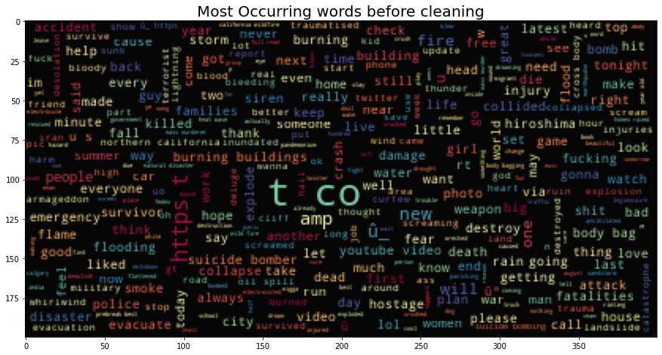
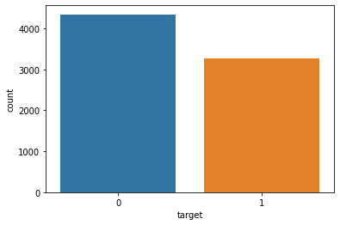
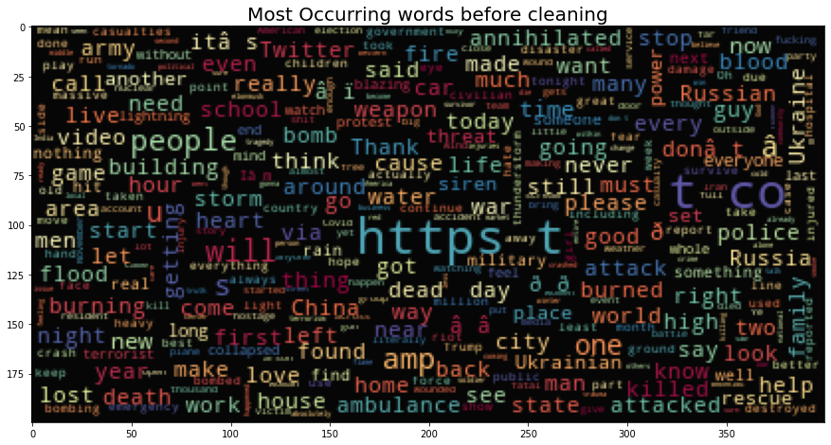
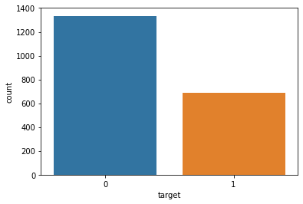
Word Clouds
Exploratory Data Analysis

Slide 4
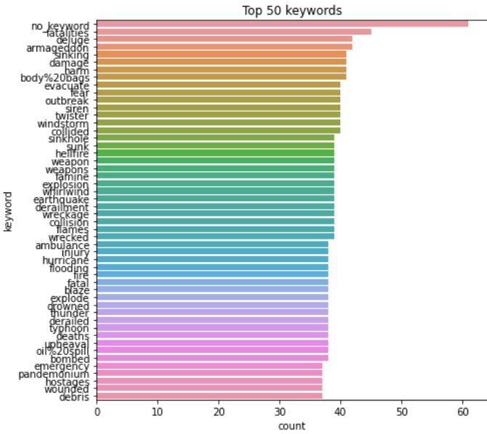
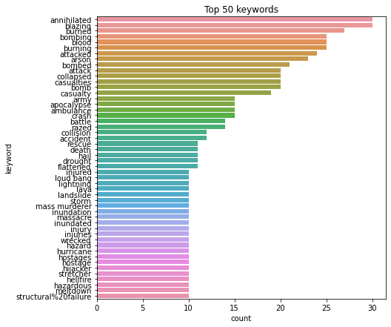
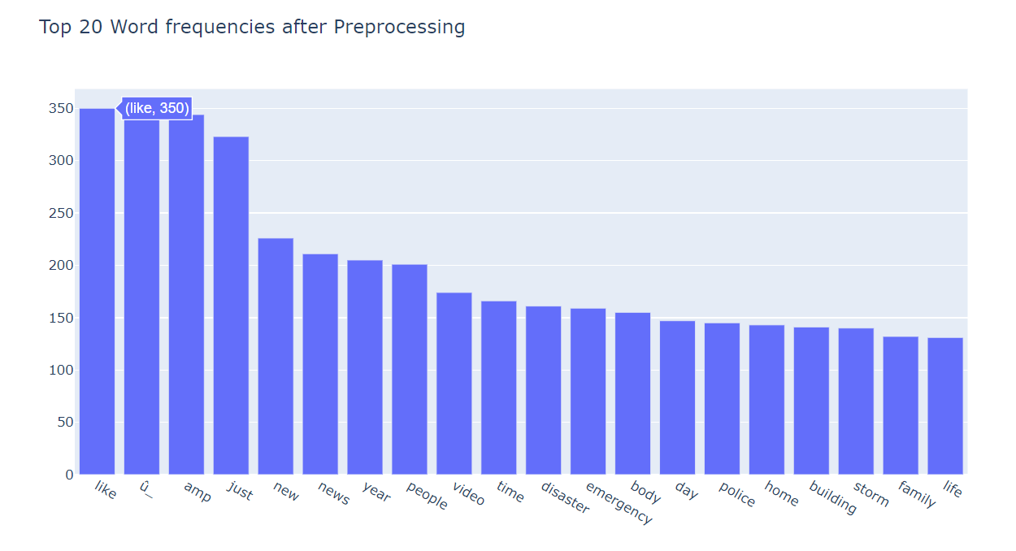
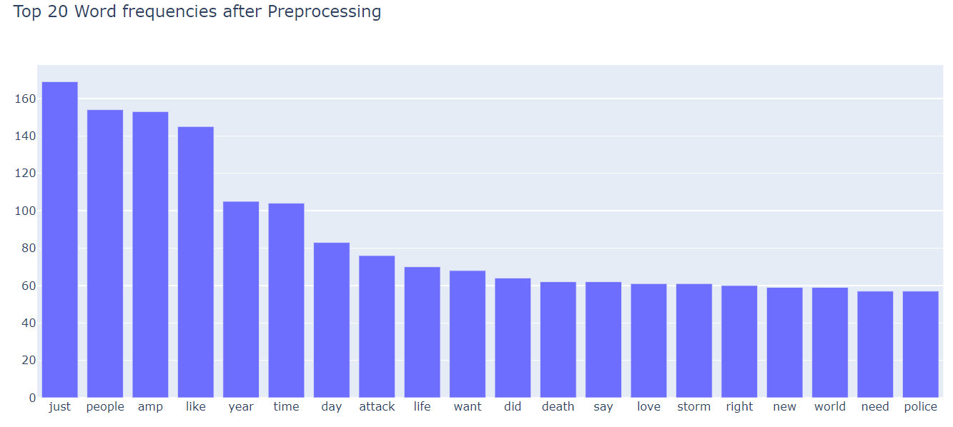
Training Dataset
Scraped Dataset

Slide 5
Implementation Summary
The training and testing of all the models implemented were acquired from an existing Kaggle Competition.
The Binary Classification and Sentiment Analysis of this Text Dataset were mainly performed with
Naive Bayes
Boosting Methods such as XGBoost, CatBoost
LSTM
Bi-LSTM
Bert and RoBERTa
The models were trained and validated on the training and testing datasets available on Kaggle.
The best of these models were then used to predict the outcomes of a dataset that was scraped by the team.

Slide 6
Twitter Dataset Scraping Tool - TWINT
The whole goal of scraping a new dataset was to test the efficacy of the models trained and validated on the Kaggle Datasets on previously unseen data.
The Twint Library is an advanced Twitter scraping tool which can be imported and run using Google Colab or on the local system. This library automatically bypasses most of the restrictions in place and provides an output that contains the Tweet, replies in a thread as well the links, mentions, emoticons and tweets by followers of a particular user.
Scraping 10 tweets on an average for 221 keywords starting from “ablaze” to “wrecked”, a total of 2019 tweets were scraped and the target values were manually provided as input, individually verifying each tweet and categorizing it as “1” for “Disaster Tweet” and “0” for “Non-Disaster Tweet”.

Slide 7
Data pre-processing
Remove the id and location columns
Remove the ampersand symbol (&)
Remove any link(s) in the tweet, hashes, retweets, mentions (that use @), multiple spaces, punctuations and convert to lowercase
Delete the duplicate tweets and remove the stopwords, performed lemmatization
Tokenize the data using the set of vocabulary

Slide 8
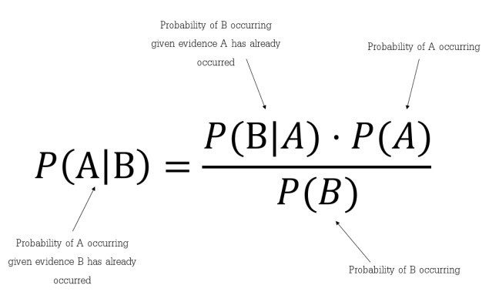
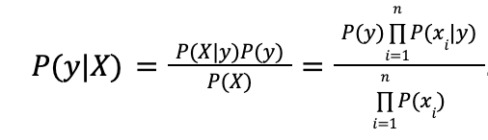
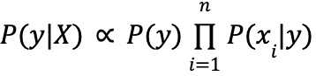
Naive Bayes Classifier
Uses Bayes’ Rule as the basis for predictions. Allows for conditioning class probabilities on input data.
Makes the additional assumption of conditional independence. Allows separation of Bayes’ rule into separate probabilities for each data point.
Conditional independence assumption is often inaccurate, but the algorithm is known to produce good results on NLP problems.
Image courtesy of KDNuggets

Slide 9
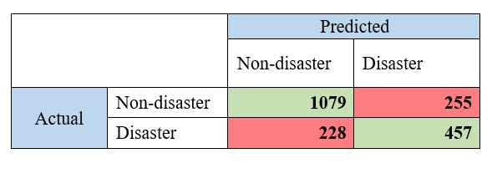
Naive Bayes Results
Ran encoded text through multinomial naive Bayes Scikit Learn model
Resulted in Kaggle score of 0.79742.
Model on scraped tweets gives confusion matrix shown here:

Slide 10
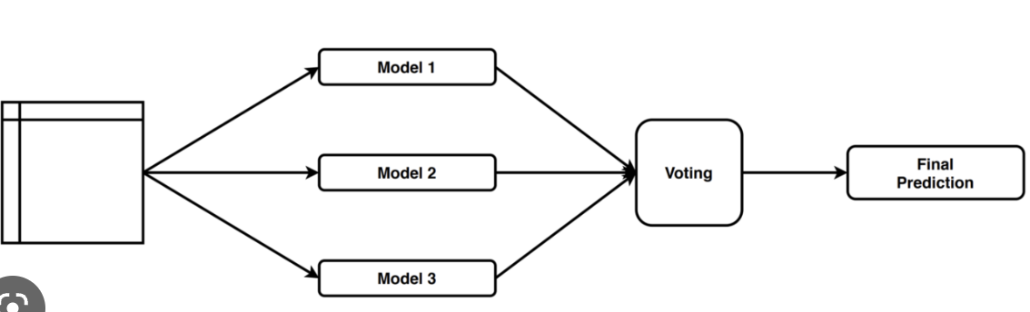
Voting Classifier
Dataset -> Fit and predict using estimators -> Soft/Hard Voting -> Final Predictions
Notes:
Hard Voting: Voting is calculated on the predicted output class.
Soft Voting: Voting is calculated on the predicted probability of the output class.

Slide 11
Implementation
Our estimators were XGBoost, CatBoost, and NaiveBayes.
We used randomized grid search to find best hyper-parameters for the models.
We used soft voting to make the final prediction.

Slide 12
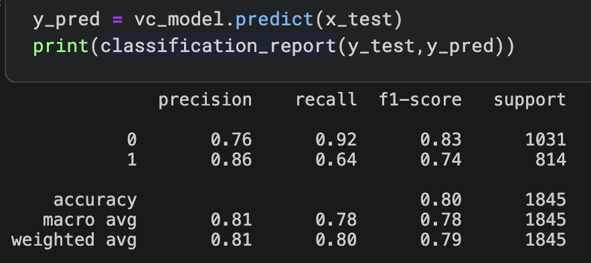
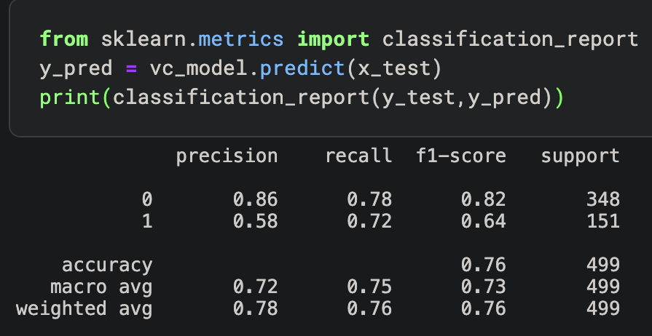
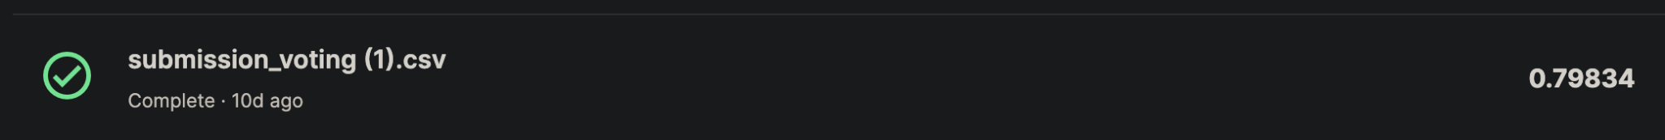
Baseline scores
Training dataset
Scraped dataset
Notes:
Gave us the best scores

Slide 13
LSTM
Long short-term memory (LSTM) is an artificial neural network specially designed to avoid problems where there is usually long term dependency.
A common LSTM unit is composed of a cell, an input gate, an output gate and a forget gate.
A LSTM usually has 4 neural network layers and 3 gates.
Used GLoVE for word vectorization to be passed as input to the LSTM model.
Built a RNN consisting of 2 layers with the learning rate and the number of epochs as 1e-5 and 400 respectively.
64 was chosen as the hidden_size parameter to the RNN which usually describes the number of features in the hidden state.

Slide 14
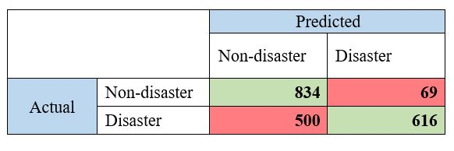
LSTM
The LSTM model ran for 121 epochs out of a possible 400 epochs due to the early stopping criteria set.
The maximum training accuracy achieved was 82.36% and the maximum validation accuracy that we achieved was 79.60%.
Submitting this model on Kaggle yielded a score of 0.79068. The confusion matrix for the scraped dataset from the LSTM model is shown below:

Slide 15
BiLSTM
For implementing the Bi-directional LSTM model, the same hyperparameters were used with a few changes to the initial LSTM model.
The LSTM model was transformed into a bi-directional LSTM model using the following syntax: bidirectional = True while initializing the neural network.
We made use of the same stopping criteria and the optimizer (Adam) implemented in the LSTM model and utilized it in the BiLSTM model.
Also, the in_features parameter, which is the size of each input sample, to the first layer of the BiLSTM model (linear module) has been doubled from the case of the LSTM model to facilitate the flow of input information in both directions.

Slide 16
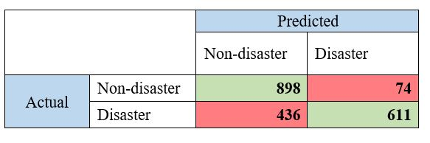
BiLSTM
The BiLSTM model ran for 123 epochs out of a possible 400 epochs due to the early stopping criteria set.
The maximum training accuracy achieved was 83.22% and the maximum validation accuracy that we achieved was 78.22%.
Submitting this model on Kaggle yielded a score of 0.79528. The confusion matrix for the scraped dataset from the BiLSTM model is shown below:

Slide 17
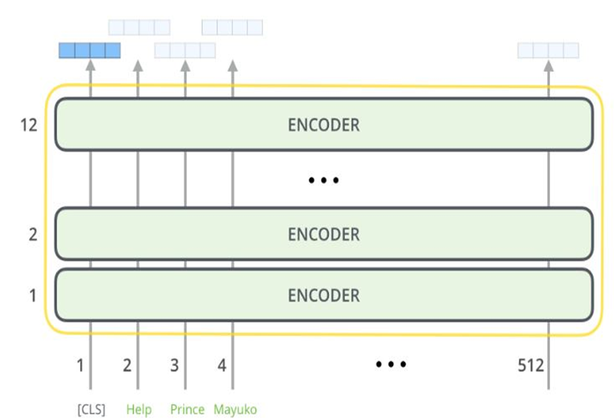
BERT
BERT (Bidirectional Encoder Representations from Transformers) is a deep learning model developed by Google that is used to power natural language processing (NLP) tasks, such as question answering and language understanding.
BERT consists of multiple layers of Transformer blocks, which are a type of neural network architecture.

Slide 18
BERT
Two models of the BERT were initially introduced:
1. BERT base – 12 layers, 12 attention heads, and 110 million parameters.
2. BERT Large – 24 layers, 16 attention heads and, 340 million parameters.
The BERT framework uses two methods for training:
1. Masked Language Modeling (MLM): In this method, some percentage of words are randomly masked and it is trained to predict these masked words
2. Next Sentence Prediction (NSP): In this method, the model receives pairs of sentences as input, and is trained to predict whether the second sentence is the next sentence to the first or not.

Slide 19
Implementation: BERT Base, Uncased
[The model weights can be found at [Bert Base uncased] (https://huggingface.co/bert-base-uncased)]
The implementation of the BERT model to the Twitter disaster dataset was done using the TensorFlow library.
In this model, we use the Bert tokenizers to create tokens for the tweets from the training dataset.
Could not achieve a training accuracy of 0.75 or more.
The training model took several hours (close to 30 hours) for training for even 10 epochs.
We shifted our focus to RoBERTa.

Slide 20
Implementation: RoBERTa
A particularly popular variant transformer is RoBERTa (or Robustly Optimized BERT Pretraining Approach) which improves upon BERT.
The literature suggests that RoBERTa improves the prediction accuracy by 2-20% over the BERT model
The implementation of the RoBERTa model to the Twitter disaster dataset was done using the PyTorch library.

Slide 21
Implementation: RoBERTa
We used a learning rate of 0.00001, epochs = 20, and early stopping criteria for training our model.
Using the best-fit model, we submitted a prediction for the test data in Kaggle. We obtained a test data accuracy of 0.83726 shown below:

Slide 22
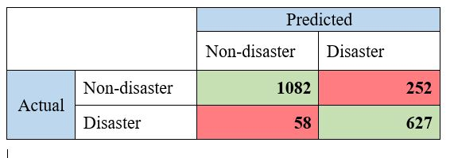
Implementation: RoBERTa
Testing using scraped Twitter data
•Using our best fit model parameters, we test our model on the scraped Twitter data.
•The accuracy of the model was obtained to be about 84.6%.
Confusion matrix

Slide 23
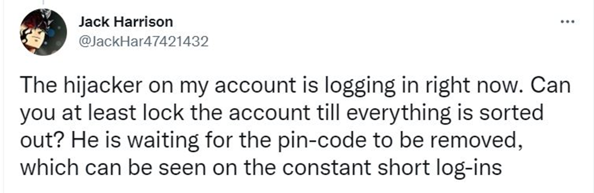
Implementation: RoBERTa
Our RoBERTa model gives a higher number of false positives than false negatives.
Example of False Negative:
Labeled: DISASTER
Predicted: NON-DISASTER

Slide 24

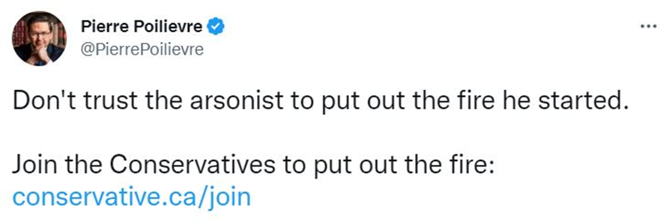
Implementation: RoBERTa
Example of False Positives:
Labeled: NON-DISASTER, Predicted: DISASTER
In danger/disaster prediction contexts, it is perhaps more desirable to have a higher number of false positives than false negatives.

Slide 25
Conclusion
In our effort, we tested the following five different models for predicting disaster tweets (along with their accuracy on the scraped dataset):
Naive Bayes Classifier : 0.772 accuracy on the scraped dataset
Voting Classifier : 0.760 accuracy on the scraped dataset
LSTM Model: 0.718 accuracy on the scraped dataset
BiLSTM Model: 0.747 accuracy on the scraped dataset
RoBERTa: 0.846 accuracy on the scraped dataset
The BERT model was the best model to train to recognize real and fake disaster tweets.
The team also recognizes that there are other models or techniques that the team could use to fine tune the model and make it more accurate.
The team also scraped from twitter and understands that the model the team made for scrapping can also be improved and optimized.
The team sees the current project as a great stepping stone to further improvements.

